Slide 1
Advanced Data Structure and Algorithms
Trees
Graphs
Hashing
Search trees, Indexing, and multiways trees
File Organization

Slide 2
UNIT 3 HASHING
Supports very fast retrieval via a key

Slide 3
Contents
Hash Table
Hash function, Bucket, Collision, Probe
Synonym, Overflow, Open hashing, Closed hashing
Perfect hash function, Load density, Full table, Load factor, rehashing
Issues in hashing
Hash functions- properties of good hash function
Division, Multiplication, Extraction, Mid-square, Folding and universal, Collision
Collision resolution strategies-
Open addressing and chaining
Hash table overflow - extended hashing
Dictionary- Dictionary as ADT, ordered dictionaries
Skip List- representation, searching and operations- insertion, removal.

Slide 4
Searching - most frequent and prolonged tasks
Searching for a particular data record from a large amount of data.
Consider the problem of searching an array for a given value.
If the array is not sorted, the search requires O(n) time
If the value ISN’T there, we need to search all n elements
If the value IS there, we search n/2 elements on average
If the array is sorted, we can do a binary search
A binary search requires O(log n) time
About equally fast whether the element is found or not
More better performance ?
How about an O(1), that is, constant time search?
We can do it if the array is organized in a particular way

Slide 5
Search performance
Binary search tree helps to improve the efficiency of searches.
From linear search to binary search, the search efficiency improved from O(n) to O(log n) .
Another data structure, called a hash table, which helps to increase the search efficiency to O(1), or some constant time.
HASHING - is a method of directly computing the address of the record through key by using a suitable mathematical function called the hash function.

Slide 6
Hash Table – Data structure for hashing
A hash table is an array-based structure used to store <key, information> pairs.
It is a data structure that stores elements and allows insertions, lookups, and deletions in O(1) time.
Is an alternative method for dictionary representation.
A hash function is used to map keys into their positions in the table – Hashing.
Hash table operations:
Search – Compute hash function f(k) & CHECK if a pair exists.
Insert – Compute function f(k) & PLACE it in appropriate position.
Delete – Compute function f(k) & DELETE the pair in that position.
In an ideal scenario, hash table search/insert/delete takes θ(1).

Slide 7
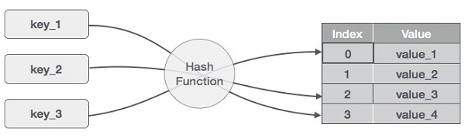
Hash Table = Array + Hash function
A hash table is made up of two parts:
an array (the actual table where the data to be searched is stored) and
a mapping function, known as a hash function.
The hash function - is a mapping from the input space to the integer space that defines the indices of the array.
Maps input space to indices

Slide 8
Hashing
The hash function provides a way for assigning numbers to the input such that the data can be stored at the array index corresponding to the assigned number.
Hashing is similar to indexing as it involves associating a key with a relative record address.
With hashing the address generated appears to be random —
No obvious connection between the key and the location of the corresponding record.
Sometimes referred to as randomizing.
With hashing, two different keys may be transformed to the same address
Two records may be sent to the same place in a file – Collision
Two or more records that result in the same address are known as Synonyms.

Slide 9
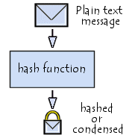
Hash Function
A hash function is a mathematical function that converts a numerical input value into another compressed numerical value.
The input to the hash function is of arbitrary length but output is always of fixed length.
Values returned by a hash function are called message digest or simply hash values.
For Key, 100 → (100 % 10) = 0 (index)
Hash function

Slide 10
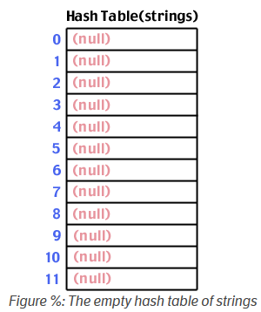
Hashing - Example
Let's take a simple example. First, we start with a hash table array of strings (Strings are used as the data being stored and searched).
Hash table size is 12
Hash table is an array [0 to Max − 1]
BUCKETS

Slide 11
Hashing - Hash function
Next we need a hash function.
There are many possible ways to construct a hash function.
Let’s take a simple hash function that takes a string as input. The returned hash value will be the sum of the ASCII characters that make up the string mod the size of the table:
String
∑ASCII characters % table_size
Hash Value
int hash (char *str, int table_size)
{
int sum = 0;
for( ; *str; str++) sum += *str; //sum of all characters
return sum % table_size;
}

Slide 12
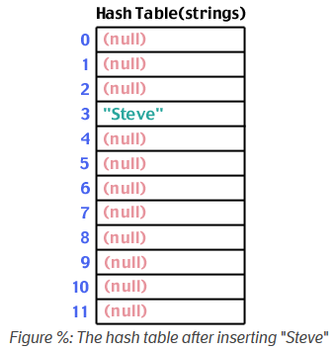
Example
Let's store a string into the table: "Steve".
We run "Steve" through the hash function, and find that hash("Steve",12) yields 3:
S:83 t:116 e:101 v:118
83+116+101+118+101 = 519
519 % 12 = 3
∑ascii character of Steve
Steve
3

Slide 13
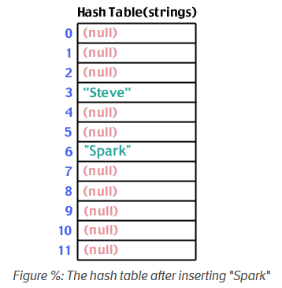
Example
Let's store a string into the table: “Spark".
We run “Spark" through the hash function, and find that hash(“Spark",12) yields 6:
∑ascii character of Spark
Spark
6
This method is known as “Division Hash Method”

Slide 14
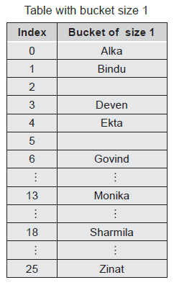
Key Terms used in Hashing
Key Term | Definition
Hash Table | Hash table is an array [0 to Max − 1] of size Max For better performance – keep table size as prime number.
Hash Function | A hash function is a mathematical function that maps an input value into an index / address. (i.e. transforms a key into an address)
Bucket | A bucket is an index position in a hash table that can store more than one record.

Slide 15
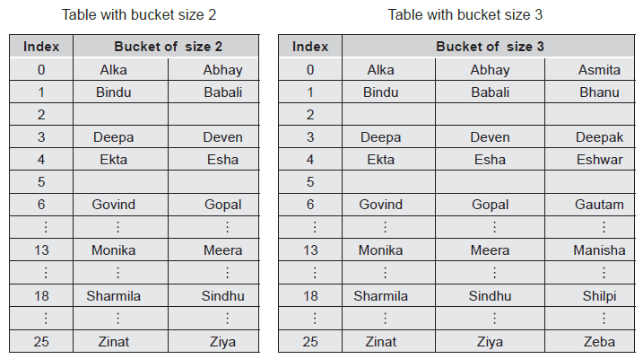
When the same index is mapped with two keys, both the records are stored in the same bucket - This is called as collision for bucket size 1.
Alternative – Buckets with multiples sizes.

Slide 16
Key Terms
Probe - Each action of address calculation and check for success is called as a probe.
Running “Spark" through the hash function, and finding an index 6 is a probe.
∑ascii character of Spark
Spark
6

Slide 17
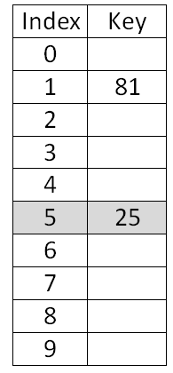
Key Terms
Collision - The result of two keys hashing into the same address is called collision.
With bucket size =1
Key % Table_size
25 % 10
25
5
Key % Table_size
55 % 10
55
5
COLLISION

Slide 18
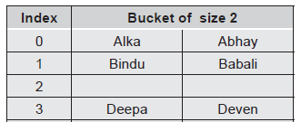
Key Terms
Synonym - Keys that hash to the same address are called synonyms.
For e.g. “25” and “55” are synonyms.
“Alka” and “Abhay” are synonyms.

Slide 19
Key Terms
Overflow - The result of
Many keys hashing to a single address and
Lack of room in the bucket is known as an overflow.
Collision and overflow are synonymous when the bucket is of size 1.

Slide 20
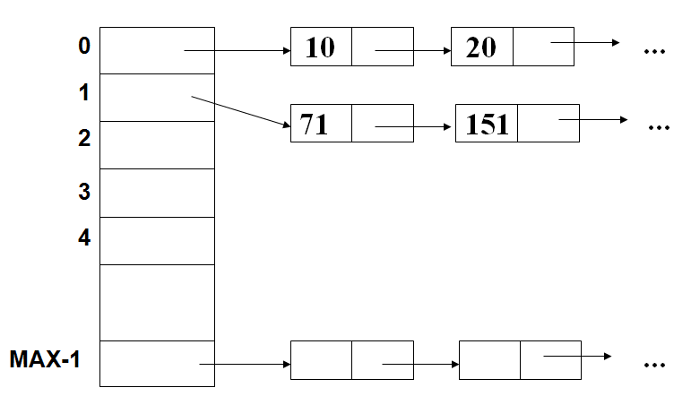
Key Terms
Open / External Hashing- Allowing the records to be stored in potentially unlimited space, it is called as open or external hashing.
How to handle bucket with size 1 for unlimited space?
Each bucket in the hash table is the head of a linked list.
All elements that hash to a particular bucket are placed on that bucket’s linked list.
Collisions are stored outside the table.
Key % 10

Slide 21
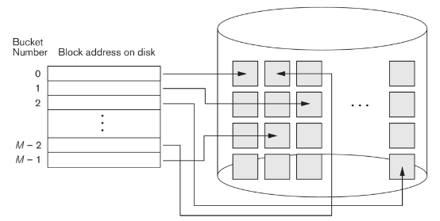
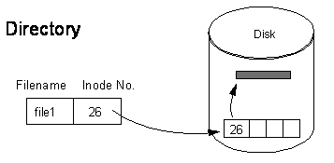
Application - Open / External Hashing
Hashing for disk files is called external hashing.
The target address space is made of buckets
Each of which holds multiple files.
A bucket is either one disk block or a cluster of contiguous disk blocks.
Inode – Index node
A reference (index) about the file and directory on the System.
LINUX

Slide 22
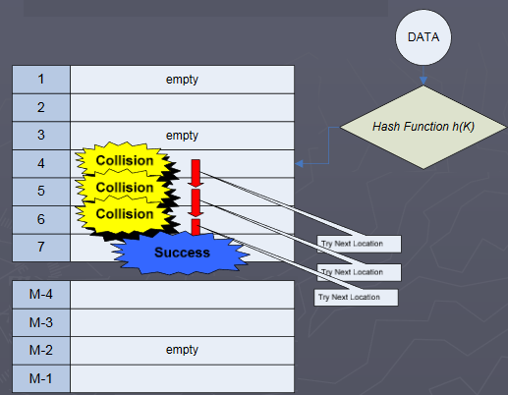
Key Terms
Closed/ Internal Hashing- When we use fixed space for storage eventually limiting the number of records to be stored, it is called as closed or internal hashing.
How to handle multiple records ?
Collisions result in storing one of the records at another slot in the table.
Limits the table size.

Slide 23
Key Terms used in Hashing
Key Term | Definition
Perfect Hash Function | The hash function that transforms different keys into different addresses with NO Collisions is called a perfect hash function. The worth of a hash function depends on how well it avoids collision.
Load density | The maximum storage capacity, i.e. the maximum number of records that can be accommodated, is called as loading density.
Full Table | All locations in the table are occupied. (Based on the characteristics of hash function; a hash function should not allow the table to get filled in more than 75%) – To handle collisions.

Slide 24
Key Terms
LOAD FACTOR- the number of records stored in a table divided by the maximum capacity of the table.
Expressed in terms of percentage.
Load Factor % = (# of records / Max) * 100
Load Factor = (2 / 10) *100 = 20%

Slide 25
Key Terms
RE-HASHING- Rehashing is with respect to closed hashing.
When we try to store the record with Key1 at the bucket position Hash(Key1) and find that it already holds a record, it is collision situation.
We can use a new hash function or the same hash function to place the record with Key1.
OR
If the table gets full, then build another table that is about twice as big with an associated NEW hash function.
The original table is scanned, and the elements are re-inserted into the new table with new hash function.
Rehashing maintains reasonable Load factor

Slide 26
Key Terms
RE-HASHING- Example with same hash function

Slide 27
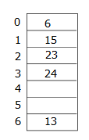
Key Terms
RE-HASHING- Example with different hash function
Consider table size as 7
Hash function Key % 7
Elements - 13, 15, 24, 14, 23, 19
NEW Table size 17 (7*2=14 & next prime is 17)
New hash function = key % 17
Old table is scanned and all the elements are inserted into new table.
14
If 19 is inserted; table will be 85% full & will affect the search performance.
Re-hashing
After inserting 13, 15, 24, 14, 23

Slide 28
Issues in Hashing
Need of good hashing function that minimizes the number of collisions.
Need of an efficient collision resolution strategy so as to store or locate synonyms.

Slide 29
Features of a good hash function
Easy and quick to compute.
Addresses generated from the key are uniformly and randomly distributed.
Small variations in the value of the key will cause large variations in the record addresses to distribute records (with similar keys) evenly.
The hashing function must minimize the occurrence of collision.
The hash function should use all input data.
The hash function should generate different hash values for similar strings.
The resultant index must be within the table index range.

Slide 30
Methods for implementing hash functions
Direct Hashing
Division method
Multiplication method
Extraction Method
Mid-square Hashing
Folding Technique
Universal Hashing
Rotation (out of scope of the course)

Slide 31
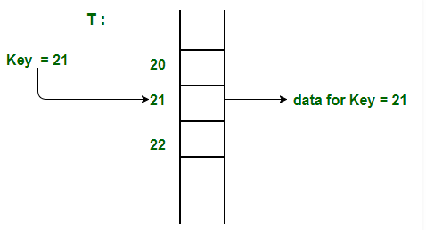
1. Direct hashing
The key is the address without any algorithmic manipulation.
It is limited and powerful as it guarantees that there are no synonyms and therefore no collision.
The data structure contains an element for every possible key.
Records are placed using their key values directly as indexes.
They facilitate fast searching, insertion and deletion operations in O(1) time.
Limitations:
Large key value.
Causes wastage of memory space if there is a significant difference between total records and maximum value.

Slide 32
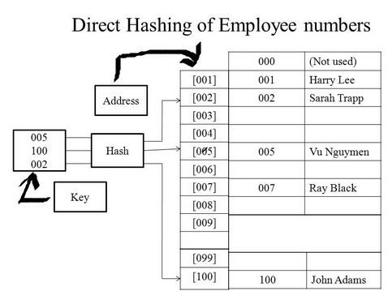
Direct Hashing

Slide 33
2. Division Hash method / modulo division method
Key is divided by some number M, and the remainder is used as the hash address of Key K.
Hash(Key) = Key % M
This function gives the bucket addresses in the range of 0 through (M - 1); so the hash table should at least be of size M.
The choice of M is critical.
A good choice of M is that it should be a prime number greater than 20.
A uniform hash function is designed to distribute the keys roughly evenly into the available positions within the hash table.

Slide 34
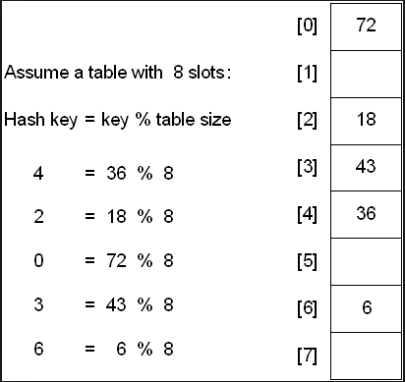
Modulo-Division
Modulo-Division Also known as Division-remainder.
Address = Key % Table size
This algorithm works with any table size, a list size that is a prime number produces fewer collisions than other list sizes.

Slide 35
3. Multiplication Method
Multiply the key ‘K’ by a constant A (approximation) in the range 0<A<1
Extract the fractional part of K * A.
Then multiply this value by M and take the floor of the result.
Where, KA % 1 is the fractional part of K * A
Donald Knuth recommended to use A = 0.61803398987 to get ideal hash function
Assuming M = 50, K = 107;
Hash (K) = Hash(107) = floor(M * (KA %1))
= floor(6.3) = 6
107 will be placed at index 6 in hash table.
KA = 66.126
Taking fractional part give 0.126
0.126*50 = 6.3
Notes:
Floor (floor value) Returns the closest integer less than or equal to a given number.

Slide 36
Multiplication Method – alternate method
(Multiply every single digits in the key) % table_size
Example –
Hash(131135) for table size 10
= (1 * 3 * 1 * 1 * 3 * 5) %10
= 45 % 10
= 5
Hash key for “Cat” on 10 buckets of size 1
Hash(Cat) for table size 10 is Hash(67+97+116)
= 280
= (2 * 8 * 0 ) %10
= 0

Slide 37
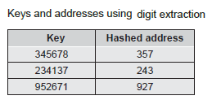
4. Digit Extraction Method
When a portion of the key is used for address calculation, the technique is called as the extraction method.
A few digits are selected, extracted from the key and are used as the address.
For example - For 6 digits book accession number; we can have 3 digits address by selecting odd number digits – 1st, 3rd, and 5th digit.
This address can be used as the address for the hash table.
Very fast; but digits/characters distribution in keys may not be even.

Slide 38
Digit Extraction Method
Another way is to extract the first two and the last one or two digits.
For example, for key 345678, the address is 3478 if the first two and the last two digits are extracted or 348 if the first two and the last digit are extracted.
OR
For 6-digit employee number get 3-digit hash address(000-999)
Select the first, third. and fourth digits (from left) and use them as the address.
140145=101
137456=174
214562=456

Slide 39
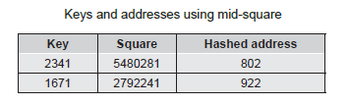
5. Mid-Square (middle of Square)
The key is squared and the middle part of the result is extracted as the hash value.
For e.g. To map the key 3121 into a hash table of size 1000 , we square it 3121= “9740641” and extract 406 as the hash value.
Disadvantage-
For large key, it is very difficult to store its square as it should not exceed the storage limit.
Preferred to be used when the key size ≤ 3 digits.

Slide 40
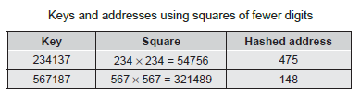
Variation on the mid-square method
Use fewer digits of the key for squaring.
i.e. select a portion of the key, such as the central 3 digits, and then use them rather than the whole key.
This allows the method to be used when the key is too large to square.
379452: 379 * 379 = 143641 = 364
121267: 121 * 121 = 014641 = 464
Works well if the keys do not contain a lot of leading or trailing zeros.

Slide 41
6. Folding Method
The key is partitioned into a # of parts, each with the same size.
The size of the subparts of the key is the same as that of the address.
The parts are then added together, ignoring the final carry, to form an address.
i.e. for a key with digits, we can subdivide the digits into three parts, add them up, and use the result as an address.
Example: If key = 356942781 and address slots are of 3 digits.
Part1 = 356, Part2 = 942, Part 3 = 781
Add them to get the sum as 2079 → ignore the final carry.
Hash value = 079

Slide 42
Folding Method
It involves splitting keys into two or more parts and then combining the parts to form the hash addresses.
To map the key 25936715 to a range between 0 and 9999 (i.e. 4 digit address), we can:
split the number into two as 2593 and 6715 &
Add these two to obtain 9308 as the hash value
Very useful if we have keys that are very large.

Slide 43
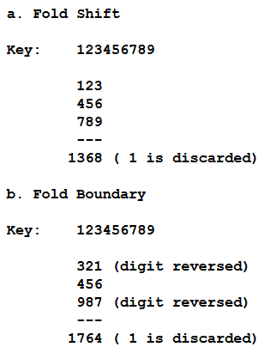
Types of folding method
There are 2 folding methods – Fold shift & Fold boundary
Fold shift, the key value is divided into parts whose size matches the size of the required address. Then the left and right parts are shifted and added with the middle part.
Fold boundary, the left and right numbers are folded on a fixed boundary between them and the center number.
Offset

Slide 44
7. Universal Hashing
N keys all of which hash to the same slot, yields an average retrieval time of O(n).
Fixed hash function is helpless for this worst-case behavior.
Solution – Universal Hashing (choose the hash function randomly)
The main idea behind universal hashing is to select the hash function at random at runtime from a carefully designed set of functions.
Because of randomization, the algorithm behaves differently on each execution; even for the same input.
This approach guarantees good average case performance, no matter what keys are provided as input.

Slide 45
Quiz
In a hash table of size 13 which index positions would the following two keys map to?
27, 130
(A) 1, 10 (B) 13, 0 (C) 1, 0 (D) 2, 3
A hash table has space for 100 records. What is the probability of collision before the table is 10% full?
(A) 0.45
(B) 0.5
(C) 0.3
(D) 0.34

Slide 46
Quiz
A hash table has space for 100 records. What is the probability of collision before the table is 10% full?
(A) 0.45
(B) 0.5
(C) 0.3
(D) 0.34
For the first time there will be no collision because all the slot is empty. Now, once the first slot is filled, after then to fill the next key in the slot there is chances of collision by 1/100. For the next key, 2/100. So 1/100 + 2/100+.............+9/100. = 0.01+0.02+0.03+.......+0.08+0.09= 0.45

Slide 47
Forms of Hashing - revisited
There are 2 different forms of hashing
Open hashing or external hashing
Close hashing or internal hashing
Open Hashing:
It allows records to be stored in unlimited space (could be Hard Disk).
It place no limitation on the size of the table.
Close Hashing:
It uses fixed space to store data.
It limits the size of the table.

Slide 48
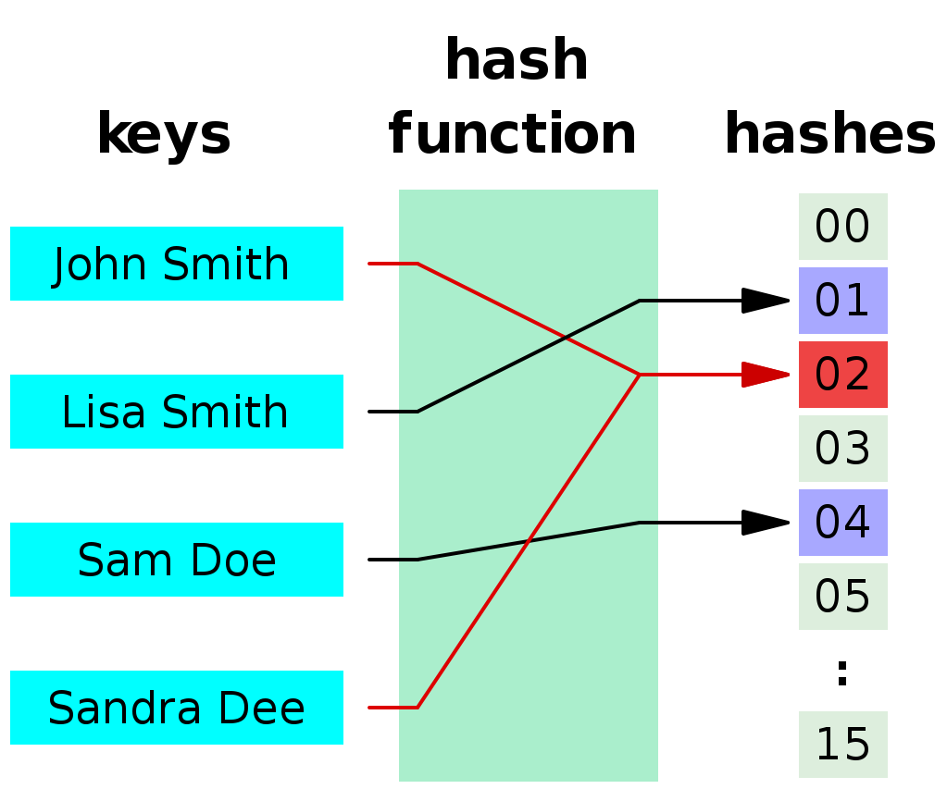
Collision in Hashing - revisited
When 2 values hash to the same array location, this is called a COLLISION
A collision occurs when hashing algorithm produced an address for an insertion key and that address is already occupied.
Collisions are normally treated as “first come, first served”—the first value that hashes to the location gets the location.
What if the second and subsequent values hash to this same location ?
John Smith & Sandra Dee hash to the same location 02 - Collision

Slide 49
Collision resolution strategies
No hash function is perfect.
If Hash(Key1) = Hash(Key2), then Key1 and Key2 are synonyms and if bucket size is 1, we say that collision has occurred.
Need to store the record Key2 at some other location.
Storing Key2 into another location known as COLLISION RESOLUTION.

Slide 50
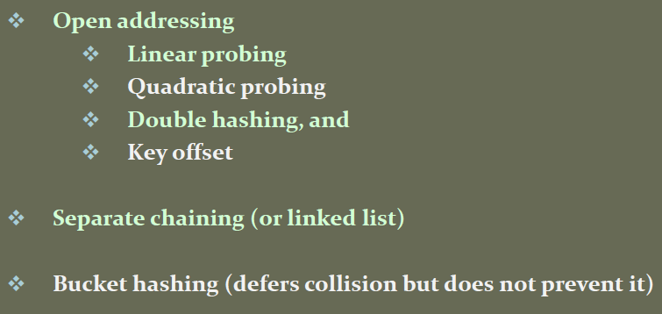
Collision Resolution methods
Collision Resolution
Open addressing
Linked List
(Separate chaining)
Bucket
Linear Probing
Quadratic Probing
Pseudo Random
Key Offset
Data CANNOT be stored in the home address or demanded address (i.e. collision)?
Resolution

Slide 51
Open addressing
Collisions are resolved by finding an available empty location other than the home address (original address).
If Hash(Key) is not empty, the positions are probed in the following sequence until an empty location is found.
End of table ?
The search is wrapped around to start and the search continues till the current collision location.
Open addressing resolve collisions in the primary area i.e. the area that contain all of the home addresses.
Large space is required for open addressing.
There are 4 methods used in open addressing i.e.
Linear probing
Quadratic Probing
Double hashing
Key Offset

Slide 52
Linear Probing
A hash table in which a collision is resolved by putting the item in the next empty place is called linear probing.
This strategy looks for the next free location until it is found.
Function - ( Hash(x) + i ) MOD Max
Where i = 1,2,3,4….till empty location is found
Example insert 76, 93, 40,47,10 and 55 into hash table of size 7.

Slide 53

Initially hash table with size 7
Key insertion method
Hash Address = key % size_of_hashtable

Slide 54
Linear Probing
Function - ( Hash(x) + i ) MOD Max
Where i = 1,2,3,4,….
Keys- 76, 93, 40, 47, 10, 55
Index | Key
0 | 47
1 | 55
2 | 93
3 | 10
4
5 | 40
6 | 76
76 % 7 = 6 (FREE)
93 % 7 = 2 (FREE)
(Hash(47) + I ) % 7
( 5 + 1 ) % 7 = 6 (Occupied)
( 5 + 2 ) % 7 = 0 (FREE)
40 % 7 = 5 (FREE)
47 % 7 = 5 (OCCUPIED)
10 % 7 = 3 (FREE)
(Hash(55) + I ) % 7
( 6 + 1 ) % 7 = 0 (Occupied)
( 6 + 2 ) % 7 = 1 (FREE)
55 % 7 = 6 (OCCUPIED)

Slide 55
Linear Probing
Function - ( Hash(x) + i ) MOD Max
Keys- 76, 93, 40, 47, 10, 55
Index | Key
0 | 47
1 | 55
2 | 93
3 | 10
4
5 | 40
6 | 76
76 % 7 = 6 (FREE)
93 % 7 = 2 (FREE)
(Hash(47) + i ) % 7
( 5 + 1 ) % 7 = 6 (Occupied)
( 5 + 2 ) % 7 = 0 (FREE)
40 % 7 = 5 (FREE)
47 % 7 = 5 (OCCUPIED)
10 % 7 = 3 (FREE)
(Hash(55) + i ) % 7
( 6 + 1 ) % 7 = 0 (Occupied)
( 6 + 2 ) % 7 = 1 (FREE)
55 % 7 = 6 (OCCUPIED)

Slide 56
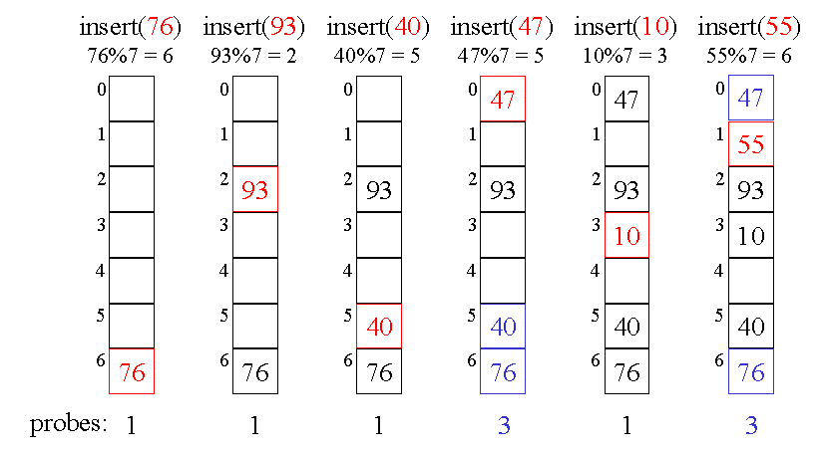
Linear Probing
Function - ( Hash(x) + i ) MOD Max

Slide 57
Linear Probing
Advantages:
It quite simple to implement.
Synonyms are stored nearer to the home address resulting in faster searches.
Disadvantages:
Problem with linear probing is primary clustering.
When many synonyms are clustered (i.e. mapped to the same location) around the home address.
High degree of clustering increases the number of probes for locating data, increasing the average search time.
The secondary clustering occurs when data is widely distributed in the hash table and have formed clusters throughout the table.

Slide 58
Linear Probing
With Replacement:
Without Replacement :

Slide 59
Linear Probing – with replacement
Address index is already occupied by the key?
There are two possibilities –
Either it is home address (collision)
Or not key’s home address
If the existing key’s actual address is different, then the NEW KEY having the address of that slot is placed at that position; and
The key with other address is placed in the next empty position.

Slide 60
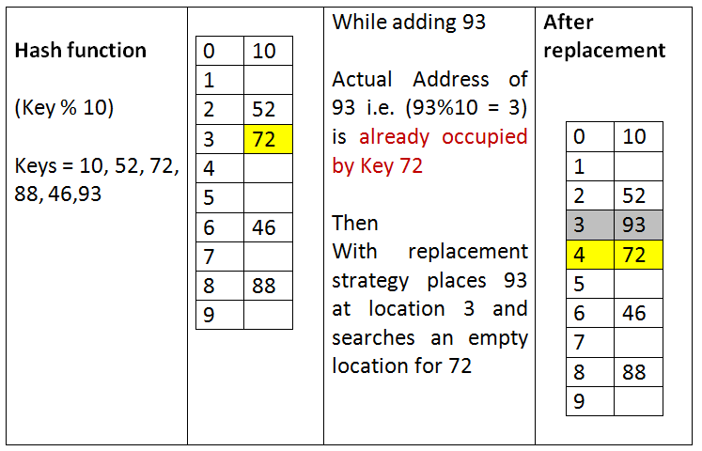
Linear Probing – with replacement
Example

Slide 61
Linear Probing – without replacement
Address index is already occupied by the key?
There are two possibilities –
Either it is home address (collision)
Or not key’s home address
In both the cases; the without replacement strategy empty position is searched for the key that is to be stored.
Another empty location is searched for a new record.

Slide 62
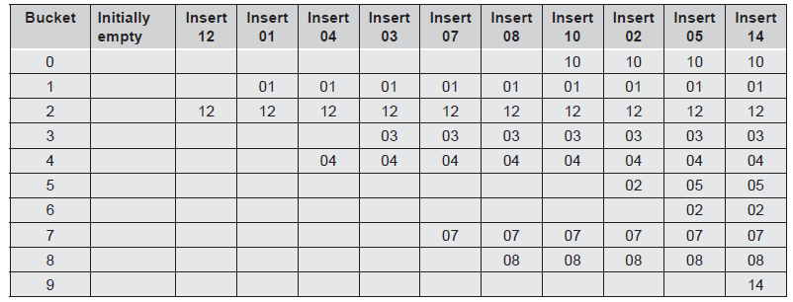
Linear Probing – Example
Store the following data into a hash table of size 10 and bucket size 1. Use linear probing for collision resolution.
12, 01, 04, 03, 07, 08, 10, 02, 05, 14
Hashing function is key % 10
Linear probing with replacement

Slide 63
Linear Probing – with replacement and chaining Chaining is linking the synonyms – for faster search
12, 01, 04, 03, 07, 08, 10, 02, 05, 14
Hashing function is key % 10
Index | Key | Chain
0 | 10 | -1
1 | 1 | -1
2 | 12 | 5
3 | 3 | -1
4 | 4 | -1
5 | 2 | -1
6 |  | -1
7 | 7 | -1
8 | 8 | -1
9 |  | -1
Index | Key | Chain
0 | 10 | -1
1 | 1 | -1
2 | 12 | 6
3 | 3 | -1
4 | 4 | 9
5 | 5 | -1
6 | 2 | -1
7 | 7 | -1
8 | 8 | -1
9 | 14 | -1
Chain for the key 2
Add key 5 and 14

Slide 64
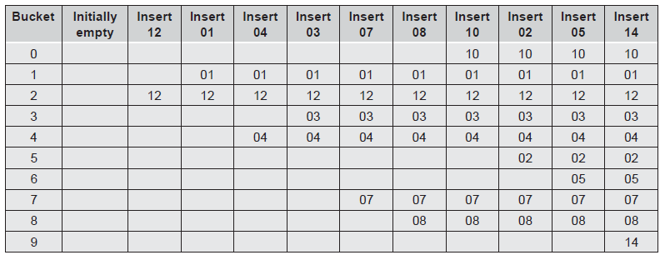
Linear Probing – Example
Store 12, 01, 04, 03, 07, 08, 10, 02, 05, 14
Hashing function is key % 10
Linear probing without replacement

Slide 65
Linear Probing – Function
//hash function to get position
int hash(int key)
{
return( key % MAX);
}
//function for inserting a record using linear probe
int linear_prob(int Hashtable[], int key) {
int pos, i;
pos = Hash(Key);
if(Hashtable[pos] == 0) // empty slot
{
Hashtable[pos] = key;
return pos;
}
Else { // slot is not empty
for(i = pos + 1; i % MAX != pos; i++) {
if(Hashtable[i] == 0) {
Hashtable[i] = key;
return i;
}
}//for
}//else
return -1;
}

Slide 66
Question
Suppose you are given the following set of keys to insert into a hash table that holds exactly 11 values:
113 , 117 , 97 , 100 , 114 , 108 , 116 , 105 , 99
Which of the following best demonstrates the contents of the has table after all the keys have been inserted using linear probing?
(A) 100, __, __, 113, 114, 105, 116, 117, 97, 108, 99 (B) 99, 100, __, 113, 114, __, 116, 117, 105, 97, 108 (C) 100, 113, 117, 97, 14, 108, 116, 105, 99, __, __ (D) 117, 114, 108, 116, 105, 99, __, __, 97, 100, 113

Slide 67
Quadratic Probe
It is a one way to reduced primary clustering.
Add the offset as the square of the collision probe number.
Quadratic probing operated by taking original hash value and adding successive values of an arbitrary quadratic polynomial to the starting value.
Hash function = ( Hash(key) + i² ) % M
M = Table size or any prime number.
i = integer number from 1 to (M-1)/2
As the offset added is NOT 1, quadratic probing SLOWS down the growth of primary clusters.

Slide 68
Quadratic Probing
Function - ( Hash(x) + i² ) % M
Where i = 1,2,3,4,…. (M-1)/2
Keys- 22, 17, 32, 16, 5, 24
Index | Key
0 | 24
1 | 22
2 | 16
3 | 17
4 | 32
5 | 5
6
22 % 7 = 1 (FREE)
17 % 7 = 3 (FREE)
32 % 7 = 4 (FREE)
16 % 7 = 2 (FREE)
5 % 7 = 5 (FREE)
(Hash(24) + i² ) % 7
( 3 + 1² ) % 7 = 4 (Occupied)
( 3 + 2² ) % 7 = 0 (FREE)
24 % 7 = 3 (OCCUPIED)

Slide 69
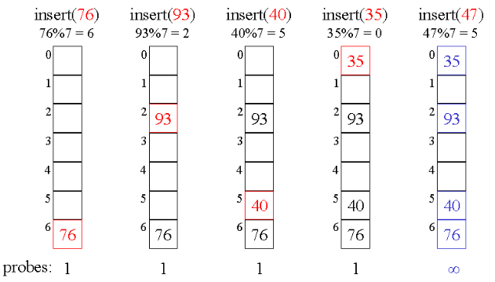
Example ☹

Slide 70
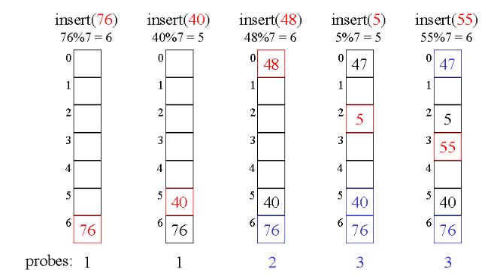
Example ☺

Slide 71
Quadratic Probe
Disadvantages:
Time required to square the probe number.
Impossible to generate a new address for every element in the list.

Slide 72
Quadratic Probing – Function
//hash function to get position
int hash(int key)
{
return( key % MAX);
}
//function for inserting a record using quadratic probe
int quadratic_prob(int Hashtable[], int key) {
int pos, i;
pos = Hash(Key);
if(Hashtable[pos] == 0) // empty slot
{
Hashtable[pos] = key;
return pos;
}
Else { // slot is not empty
for(i = 1; i % MAX != pos; i++){
pos = (pos + i * i ) % MAX;
if(Hashtable[pos] key == 0) {
Hashtable[pos] = key;
return pos;
}
}//for
} // Else return -1;
}

Slide 73
Open Hashing
Closed Hashing
Open Addressing
Linear Probing
Quadratic Probing

Slide 74
Primary and secondary clustering
When many synonyms are clustered around the home address, it is known as PRIMARY clustering.
The SECONDARY clustering occurs when data is widely distributed in the hash table and have formed clusters throughout the table.
High degree of clustering increases the number of probes for locating data, increasing the average search time.

Slide 75
Elimination of Primary & Secondary Clustering- DOUBLE HASHING
All types of clustering can be eliminated by double hashing, which involves the use of 2 hash function h1(key) and h2(key).
One for accessing the home address (position) of a Key.
The other for resolving the conflict.
Sequence-
[ (Hash1(Key), (Hash1(Key) + i * Hash2(Key)), ….] % MAX
Where, i = 1, 2, 3, 4, …

Slide 76
Pseudorandom collision resolution
The last two method are collectively known as double hashing
Following rules are used for double hashing:
Hash1(key) = key % M
M is Hash_table_size
Hash2(key) = R - (Key % R)
R = any prime number < M

Slide 77
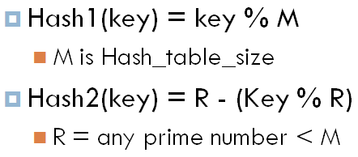
Example
Keys - 12, 01, 18, 56, 79, 49
Hash1 function – Key % 10
[ (Hash1(Key), (Hash1(Key) + i * Hash2(Key)), ….] % MAX
Index | Key
0
1 | 01
2 | 12
3 | 49
4
5
6 | 56
7
8 | 18
9 | 79
12 % 10 = 2 (FREE)
(Hash(49) = [Hash1(49) + Hash2(49)] % 10
01 % 10 = 1 (FREE)
(Hash2(49) = R – (Key % R)
= 7 – (Key % 7)
= 7 – (49% 7)
= 7 – 0 = 7
18 % 10 = 8 (FREE)
56 % 10 = 6 (FREE)
(Hash(49)
= [Hash1(49) + Hash2(49)] % 10
= (9 + 7 ) % 10 = 6 (OCCUPIED)
79 % 10 = 9 (FREE)
(Hash(49)
= [Hash1(49) + 2 * Hash2(49)] % 10
= (9 + 14 ) % 10 = 3 (FREE)
49 % 10 = 9 (OCCUPIED)

Slide 78
Example
Create a hash table for 37,90,45,22,17,49
Hash table size =10
Index | Value
0 | 90
1
2 | 22
3
4
5 | 45
6
7 | 37
8
9 | 49
Insert 37,90,45,22,49
Key % 10

Slide 79
Index | Value
0 | 90
1
2 | 22
3
4
5 | 45
6
7 | 37
8
9 | 49
Insert 17
Key % 10
M-(key%M)
Insert 17
H1(17)=17%10 but it already occupied

Slide 80
Calculate H2
H2(key)=M-(key%M)
H2(17)=7-(17%7)=7-3=4
Hash(17) = (7 + 4)%10 = 1
Index | Value
0 | 90
1 | 17
2 | 22
3
4
5 | 45
6
7 | 37
8
9 | 49
Insert 17
Key % 10
M-(key%M)

Slide 81
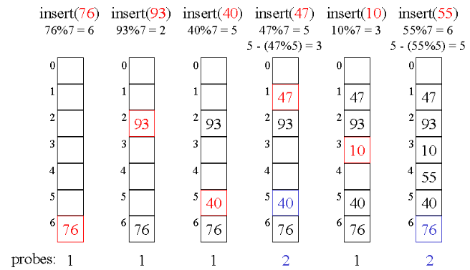
example

Slide 82
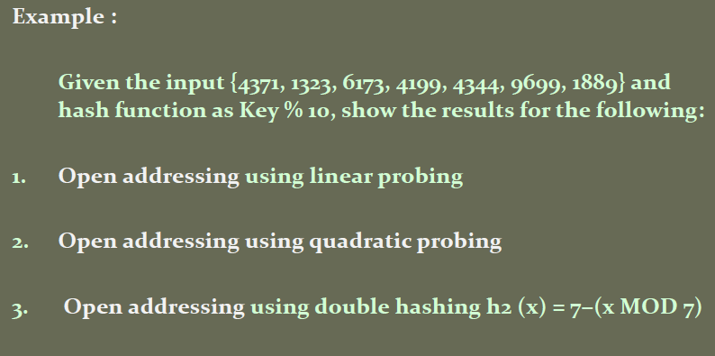

Slide 83
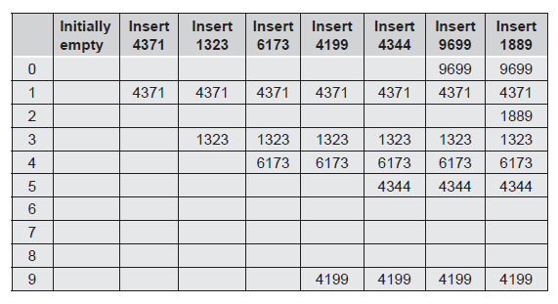
Linear Probing

Slide 84
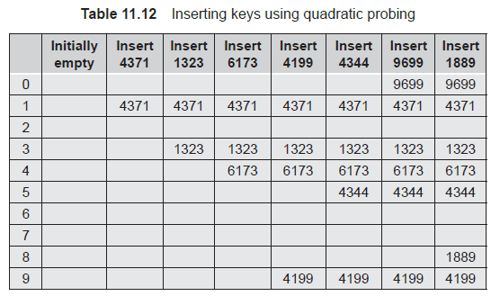
Quadratic Probing
Hash function = ( Hash(key) + i² ) % M

Slide 85
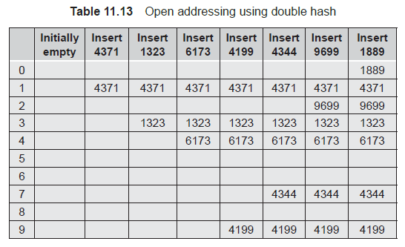
Double Hashing
[ (Hash1(Key), (Hash1(Key) + i * Hash2(Key)), ….] % MAX

Slide 86
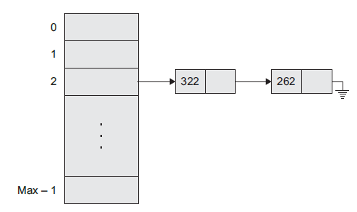
Chaining – (Separate chaining)
This technique is used to handle synonym.
It chains together all the records that hash to the same address.
A linked list of synonyms is created whose head is home address of synonyms.
Pointers are handled to form a chain of synonyms.
The EXTRA memory is needed for storing pointers.

Slide 87
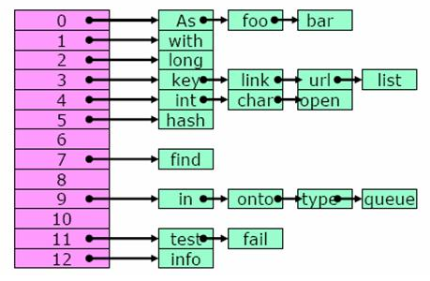
Separate Chaining
The idea here is to resolve a collision by creating a linked list of elements as shown below.

Slide 88
Chaining Vs. Rehashing
Chaining | Rehashing
Unlimited number of synonyms can be handled. | A limited but good number of synonyms are taken care of.
Additional cost to be paid is an overhead of multiple linked lists. | The table size is doubled but no additional fields of links are to be maintained.
Sequential search through the chain takes more time. | Searching is faster when compared to chaining.

Slide 89
Open Addressing Vs. Closed Addressing
Closed Addressing | Open Addressing
Records are stored in potentially unlimited space – (open or external hashing). | Records are stored in fixed space is called as closed or internal hashing.
Each bucket in the hash table is the head of a linked list. | The fixed storage space eventually limits the number of records to be stored.
All elements that hash to a particular bucket are placed on bucket’s linked list. | All elements that hash to a particular bucket are re-probed or rehashed.
Collisions are stored outside the table. | Collisions result in storing one of the records at another slot in the table.

Slide 90
Hash table overflow
Collisions will occur !!
An overflow is said to occur when a new identifier(key) is mapped or hashed into a full bucket.
With the bucket size as one, collision and overflow occur simultaneously.
Techniques for handling overflow of records –
Overflow handling with Open Addressing
On collision; find the closest unfilled bucket through linear probing or linear open addressing
Overflow handling with Chaining
On collision, append new key in the bucket’s chain.
Each chain has a head node.

Slide 91
Hash table overflow – Linear probing revisited
Compute Hash(I)
Examine identifiers position
Table[Hash(I)], Table[Hash(I) + 1], …, Table[Hash[I] + i], in order until key is mapped to the index.
If we return to the start position Hash(I), then the table is full and I is not in the table.

Slide 92
Extendible Hashing
On collisions, with linear probing or separate chaining; several blocks are required to be examined to search a key.
On table overflow/full; rehashing is needed.
For fast searching and less disk access, EXTENDIBLE hashing is used.
It is a type of hash system, which treats a hash as a bit string, and uses a trie (prefix or digital tree) for bucket lookup.
It minimizes Re-hashing.
Widely used in databases.

Slide 93
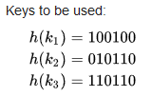

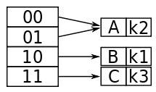

Extendible Hashing - Example
Hash function Hash(Key) returns a binary number.
With bucket size as 1
No space for Key 3
First 2 most significant bits

Slide 94
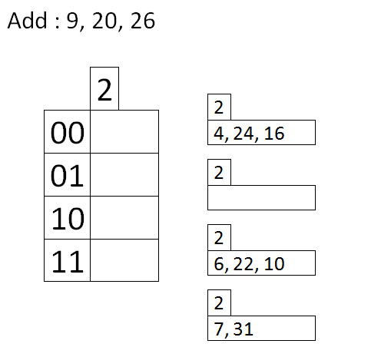
Extendible Hashing - Example
Hash function Hash(Key) returns a binary number.
Global depth – 2 right most bits
Local depth - 2 means 3 values (0, 1, 2)
To add 9 ; binary value is 1001
Take 2 right most bits i.e. 01
9
To add 20 ; binary value is 10100
Take 2 right most bits i.e. 00
In bucket, 00- local depth is 2 i.e. overflow & global depth is also 2 – then double the table ie.
000, 001, 010, ………………..111

Slide 95
Dictionaries
It is a collection of the forms (k, v) where k is the key and v is the value associated with the key (equivalently, v is the value whose key is k).
An unordered collection of distinct elements.
No two pairs in dictionary have the same key.
Multiset is a set whose members are not necessarily distinct.
Operations are performed on dictionary
Determine whether dictionary is empty or not
Determine the dictionary size.
Find the pair with specific key.
Insert pair into the dictionary.
Delete the pair from dictionary.

Slide 96
Cont..
The word dictionary is a collection of pairs; each pair comprises a word and its value.
The value of the world include the meaning of the world, the pronunciation, verbal nouns, and so on.
Examples :
Webster’s dictionary
Telephone dictionary

Slide 97
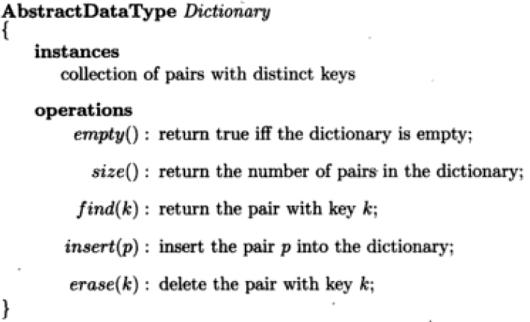
Dictionary ADT

Slide 98
Hashing - Applications
In compilers – (as symbol table) to keep track of declared variables/functions/class/keywords, etc.
Online spelling checking.
Game playing programs – to store the moves made.
In browser programs – for caching the web pages.
Security – cryptography in form of hash functions.
Password verifications
Programming-
HashSet and HashMap in Java
Dict in Python

Slide 99
Skip List
A balanced tree is one of the most popular data structures used for searching.
One of the variants of balanced trees is the skip list.
The skip list is a probabilistic data structure.
Used by many search-based applications instead of balanced trees.
A skip list stores the sorted data in the form of a linked list.
Items are stored as a hierarchy of linked lists where each list links increasingly sparse subsequences of the items.
These supplementary lists result in an item search that is as efficient as that of balanced binary search trees.
Since each link of the sparser lists skips over many items of the full list in one step, the list is called skip list.

Slide 100
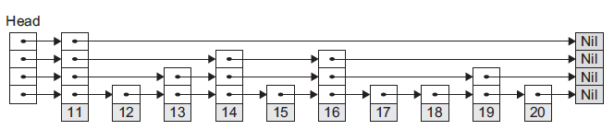
Skip List
These forward links are added on the basis of the probability of the element search.
Hence, insert, search, and delete operations are performed in logarithmic expected time.
Skip list algorithms are simpler, faster, and use less space.
Diagrammatic representation of a skip list-

Slide 101
Skip List- representation, searching and operations- insertion, removal. (refer attached ppt by student’s group)

